Slide 1
FY18 NJCEP Reporting*
as of May 2018
*Note: the results presented here are preliminary and are subject to change

Slide 2
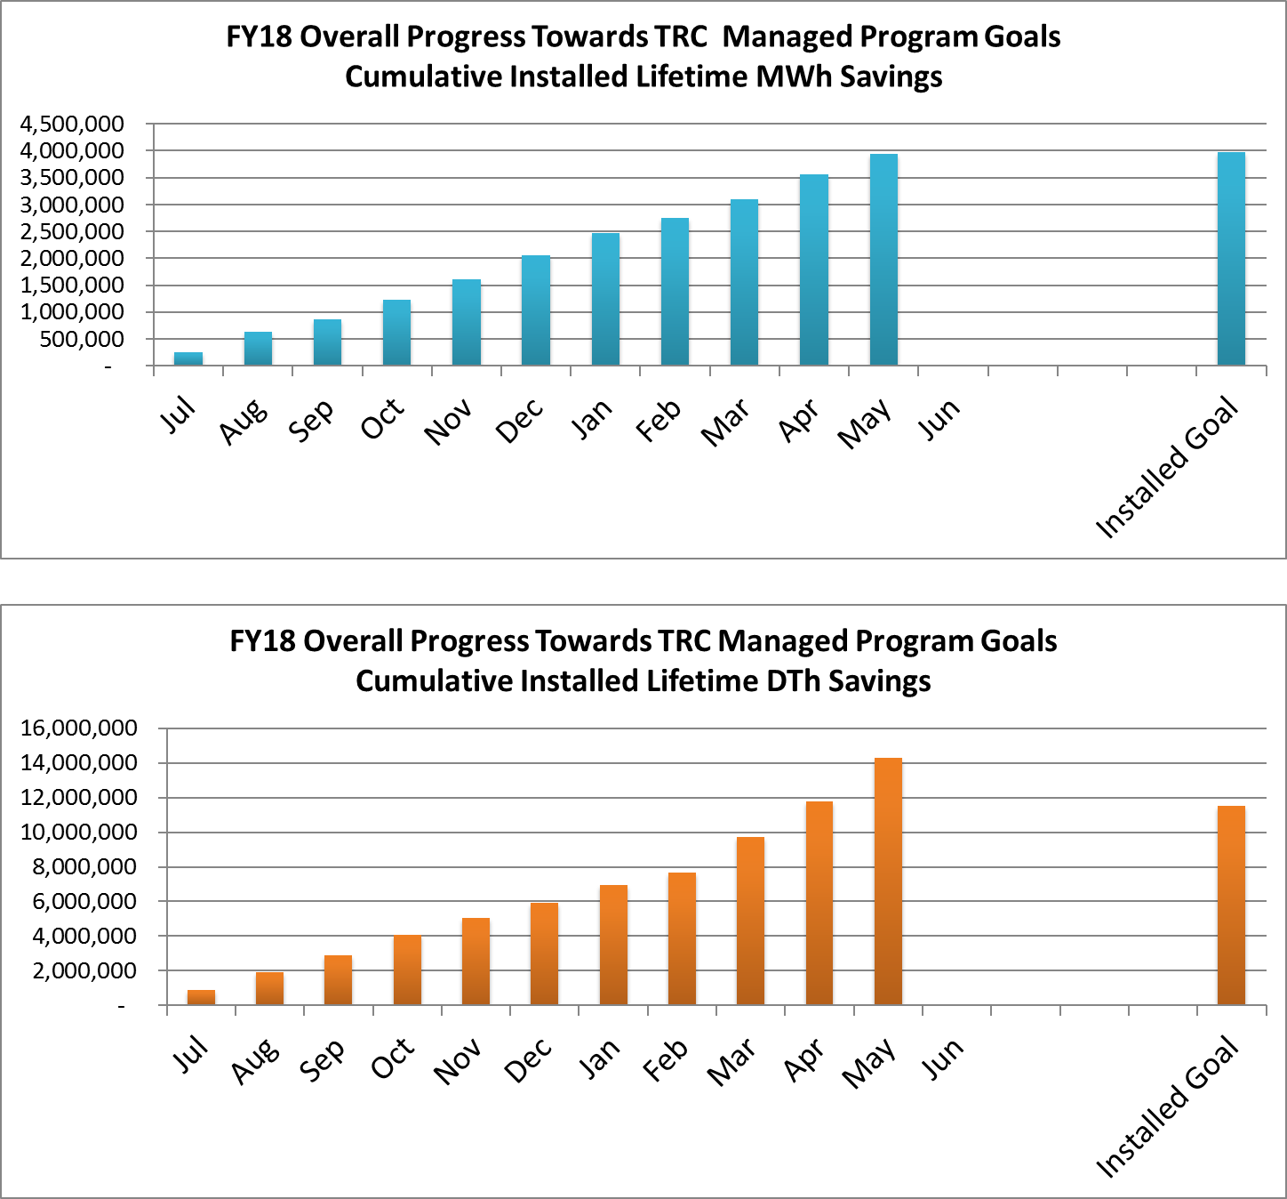
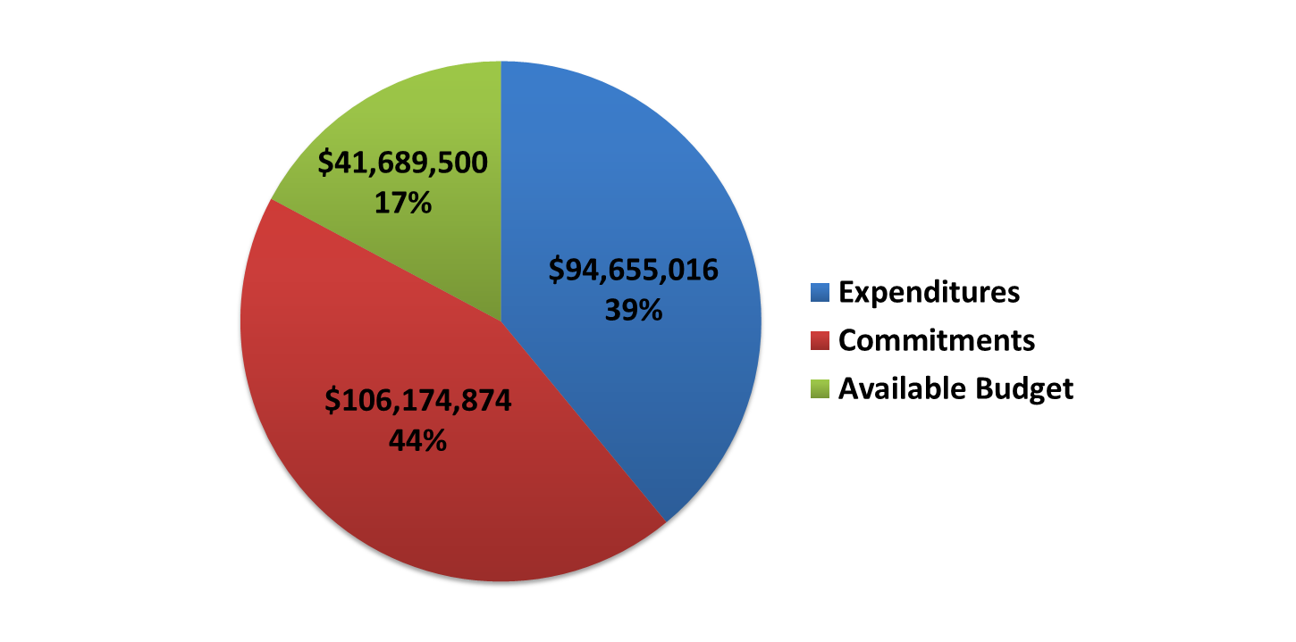
Overall progress towards TRC Managed program goals
FY18 Incentive Budget: $242,519,390

Slide 3
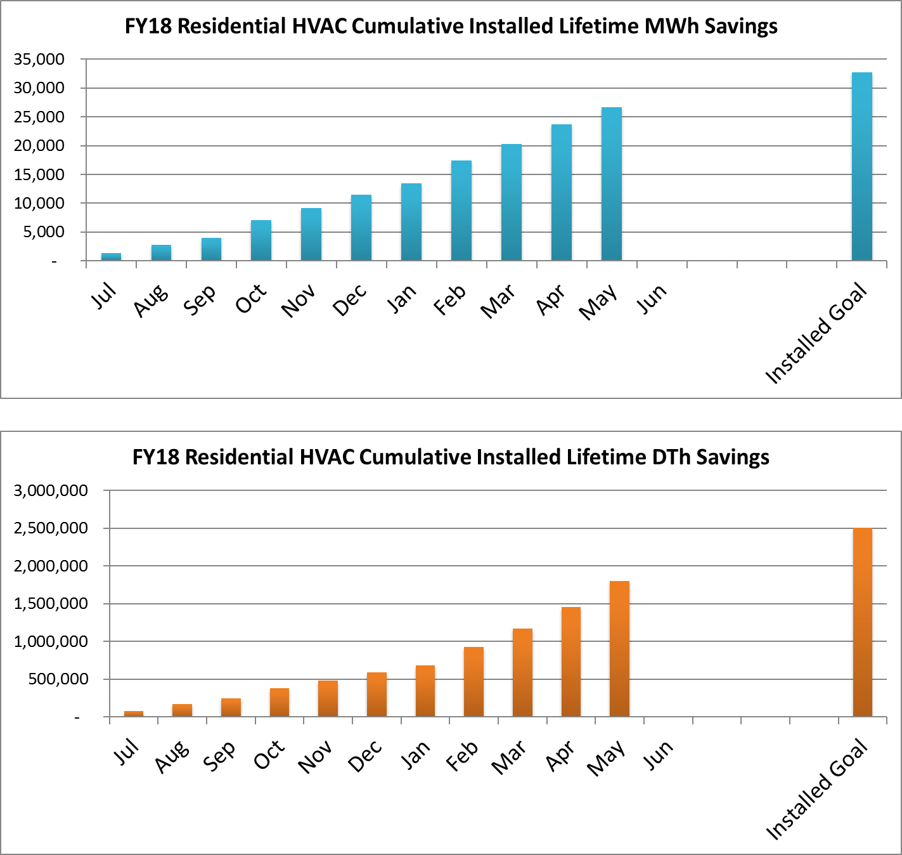
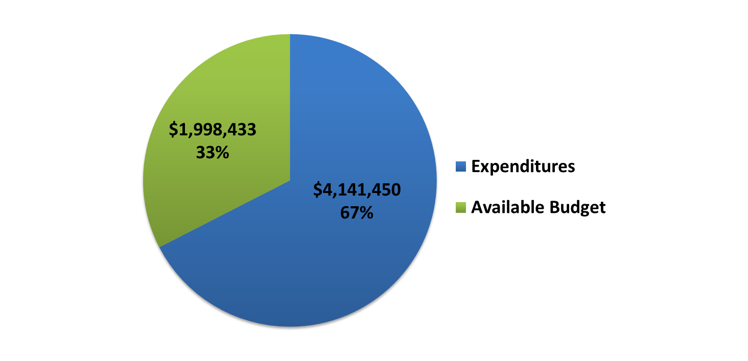
Residential hvac
Program Highlights
A high volume of HVAC applications were received this month (520)
State Energy Program (SEP) funding remaining as of 5/31/18: $100,845

Slide 4
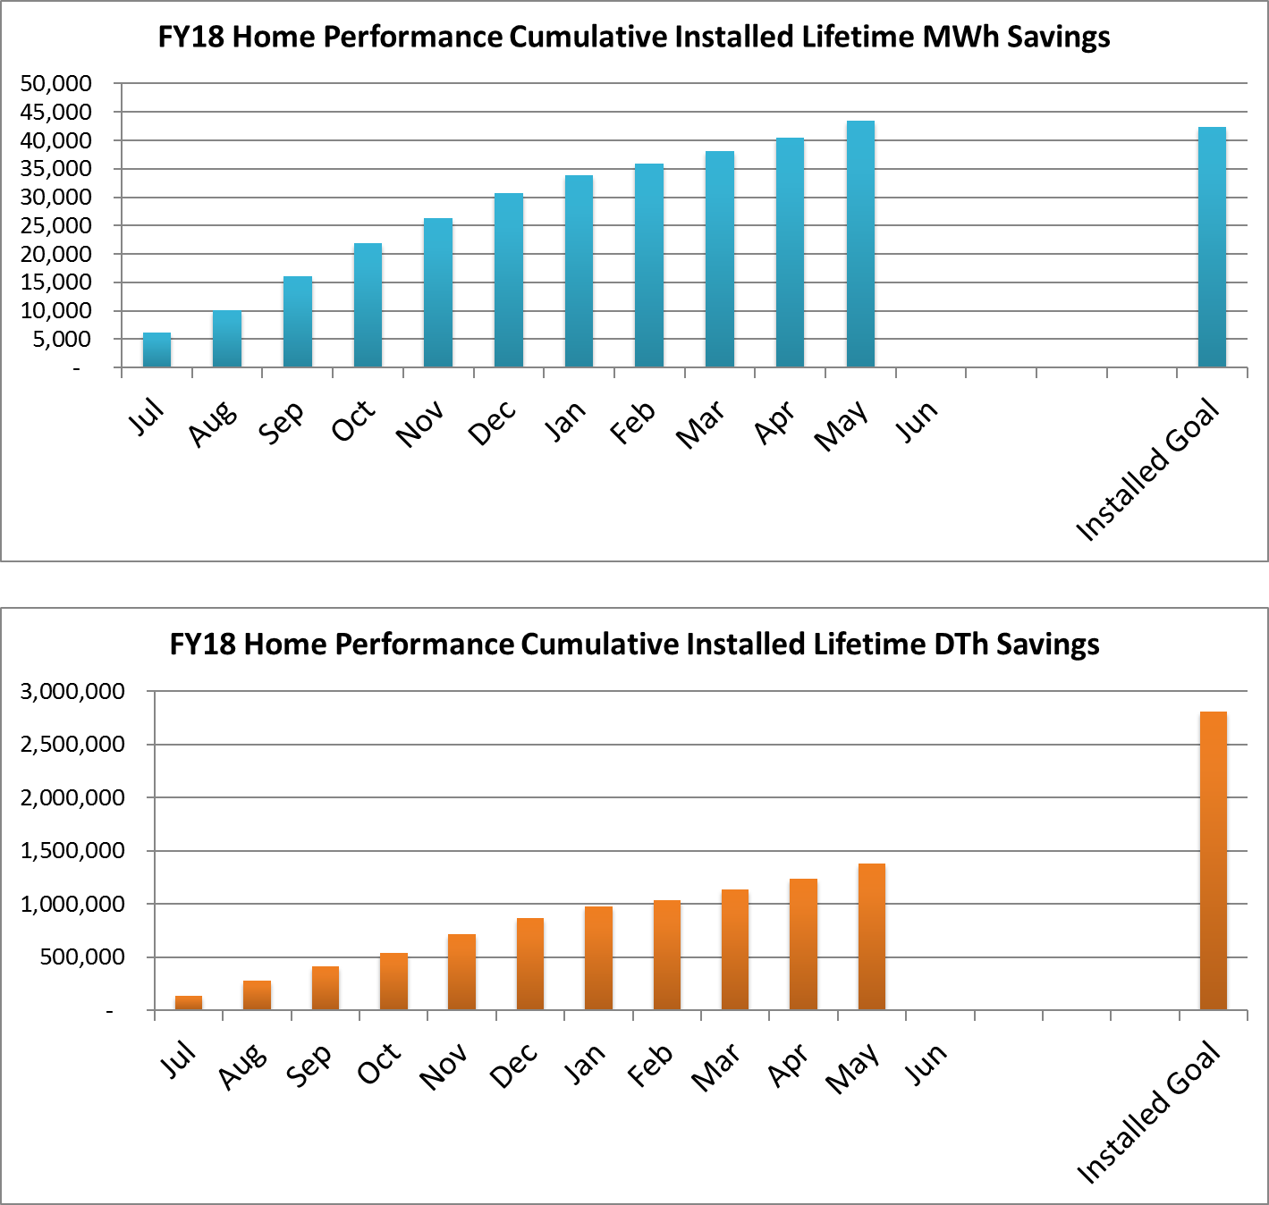
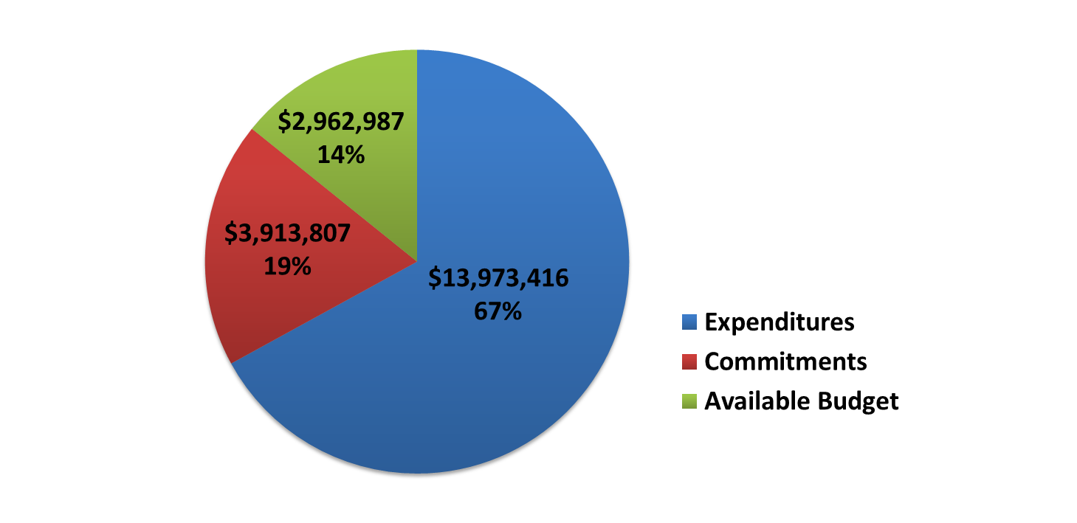
Home performance with energy star®
Program Highlights
5 contractors attended the Home Performance orientation. The total number of contractors delivering the program is 94.
Over $229,000 of co-op incentives have been approved for payment since this component of the program re-opened in August
State Energy Program (SEP) funding remaining as of 5/31/18: $63,678

Slide 5
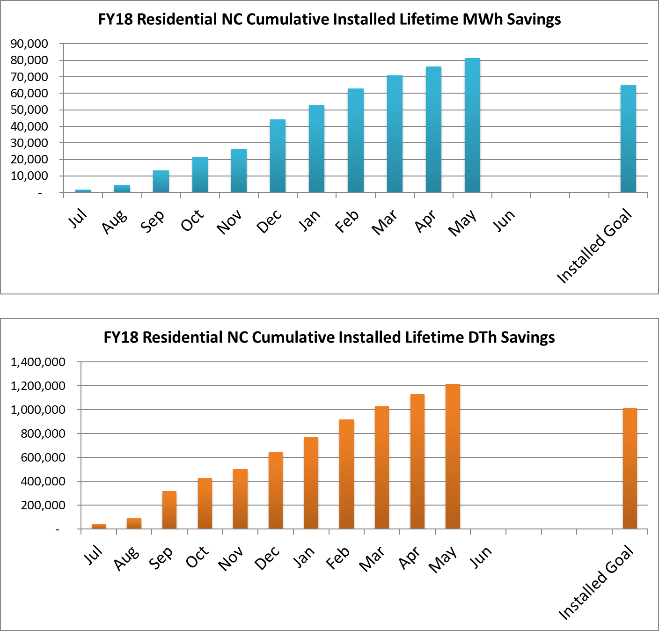
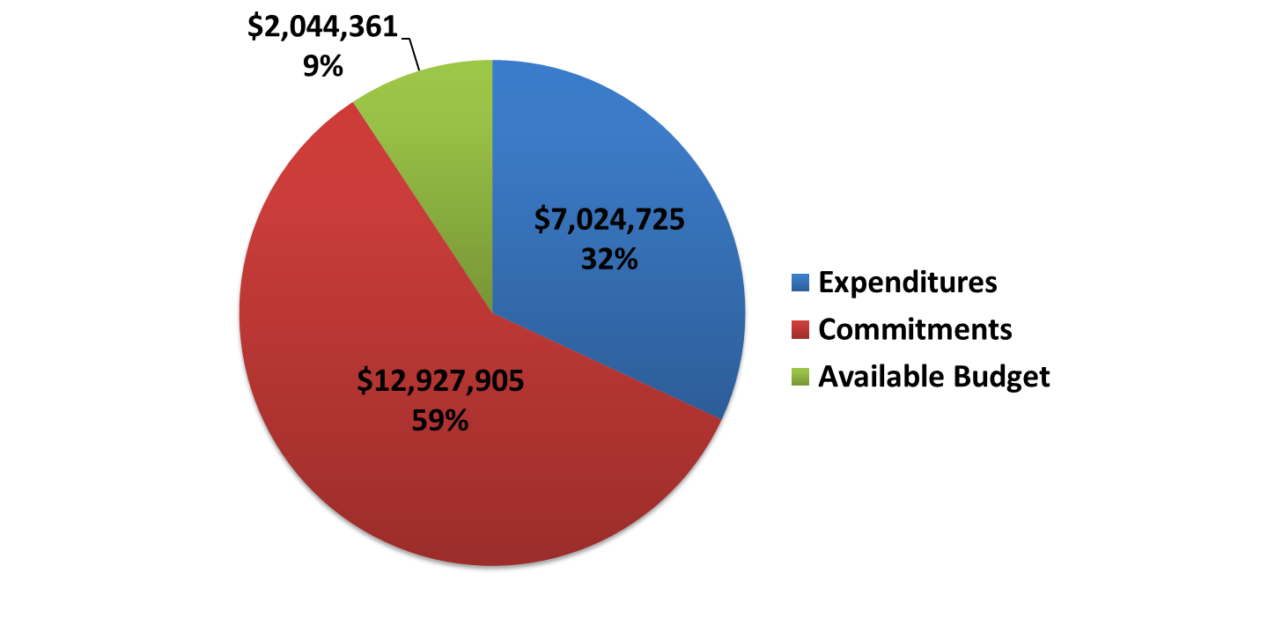
Residential new construction
Program Highlights
Targeted outreach to architects was a specific focus this month
Multi-family sites represent two-thirds of projects submitted

Slide 6
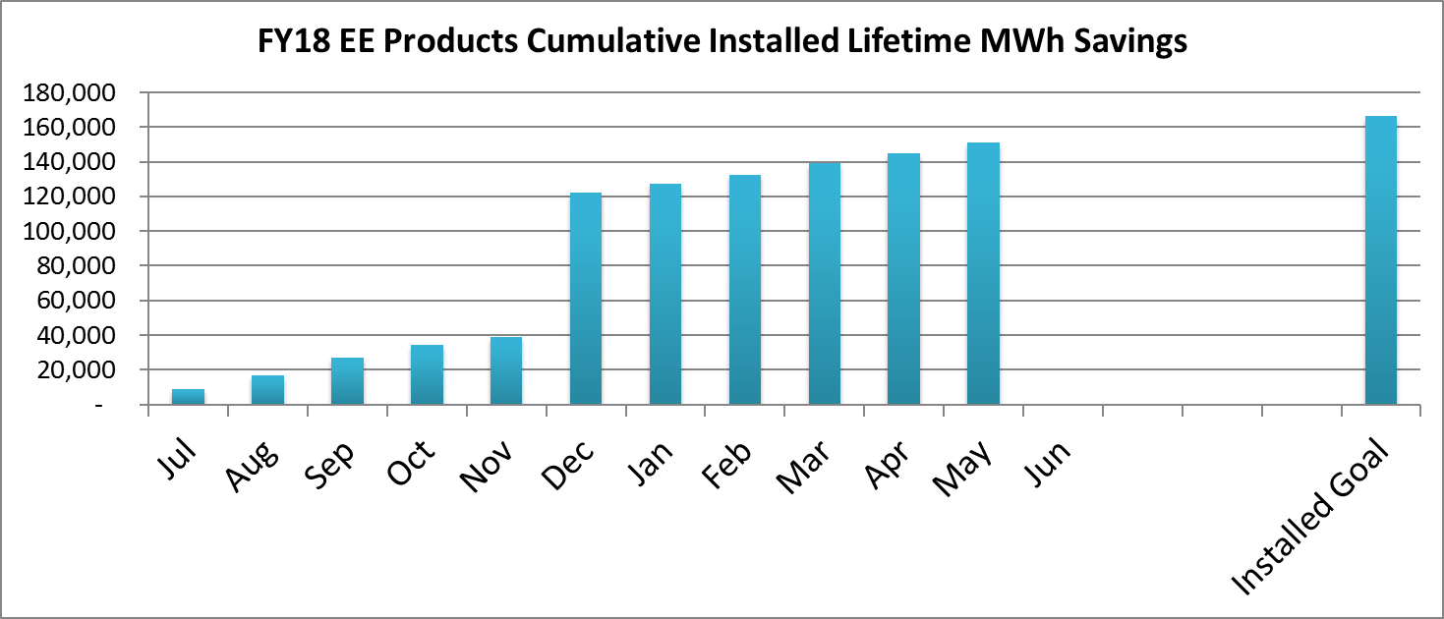
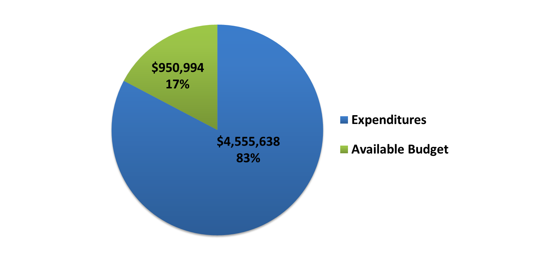
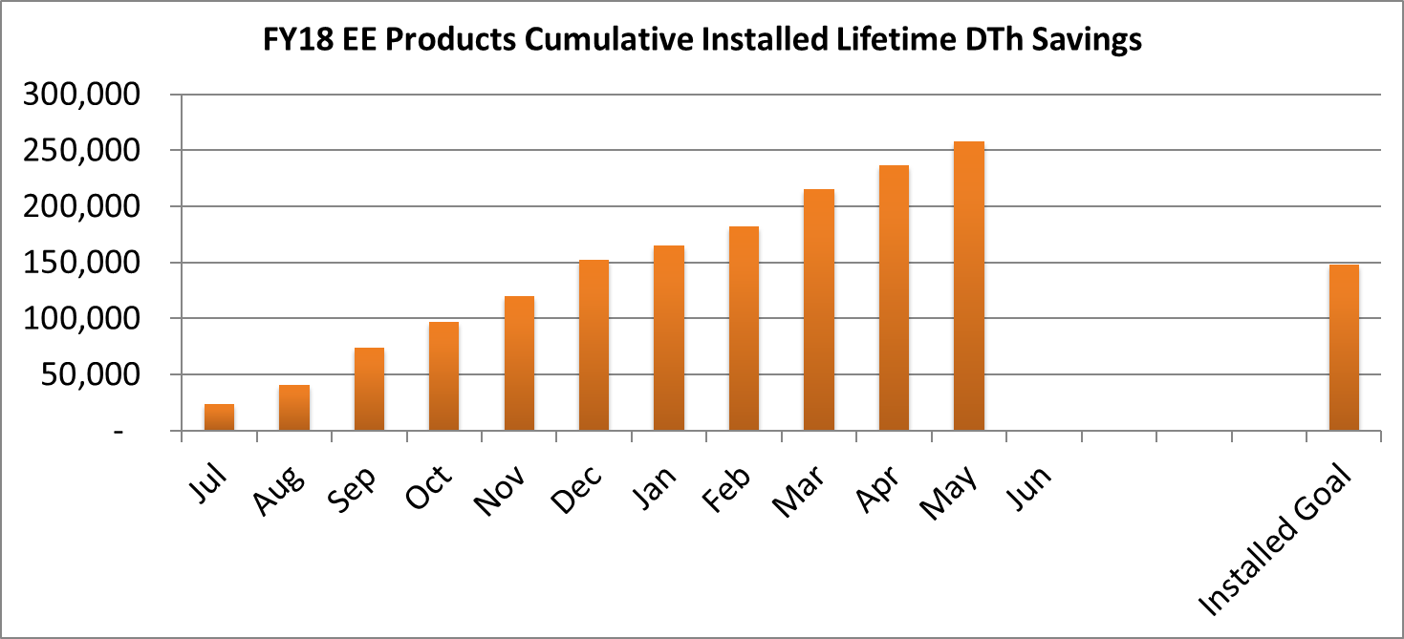
Energy efficient products
(includes: appliance rebates and recycling, RETAIL LIGHTING)
Program Highlights
Spring Cleaning: Appliance Recycling experienced a 12% increase in volume compared to April
Retail lighting remains closed

Slide 7
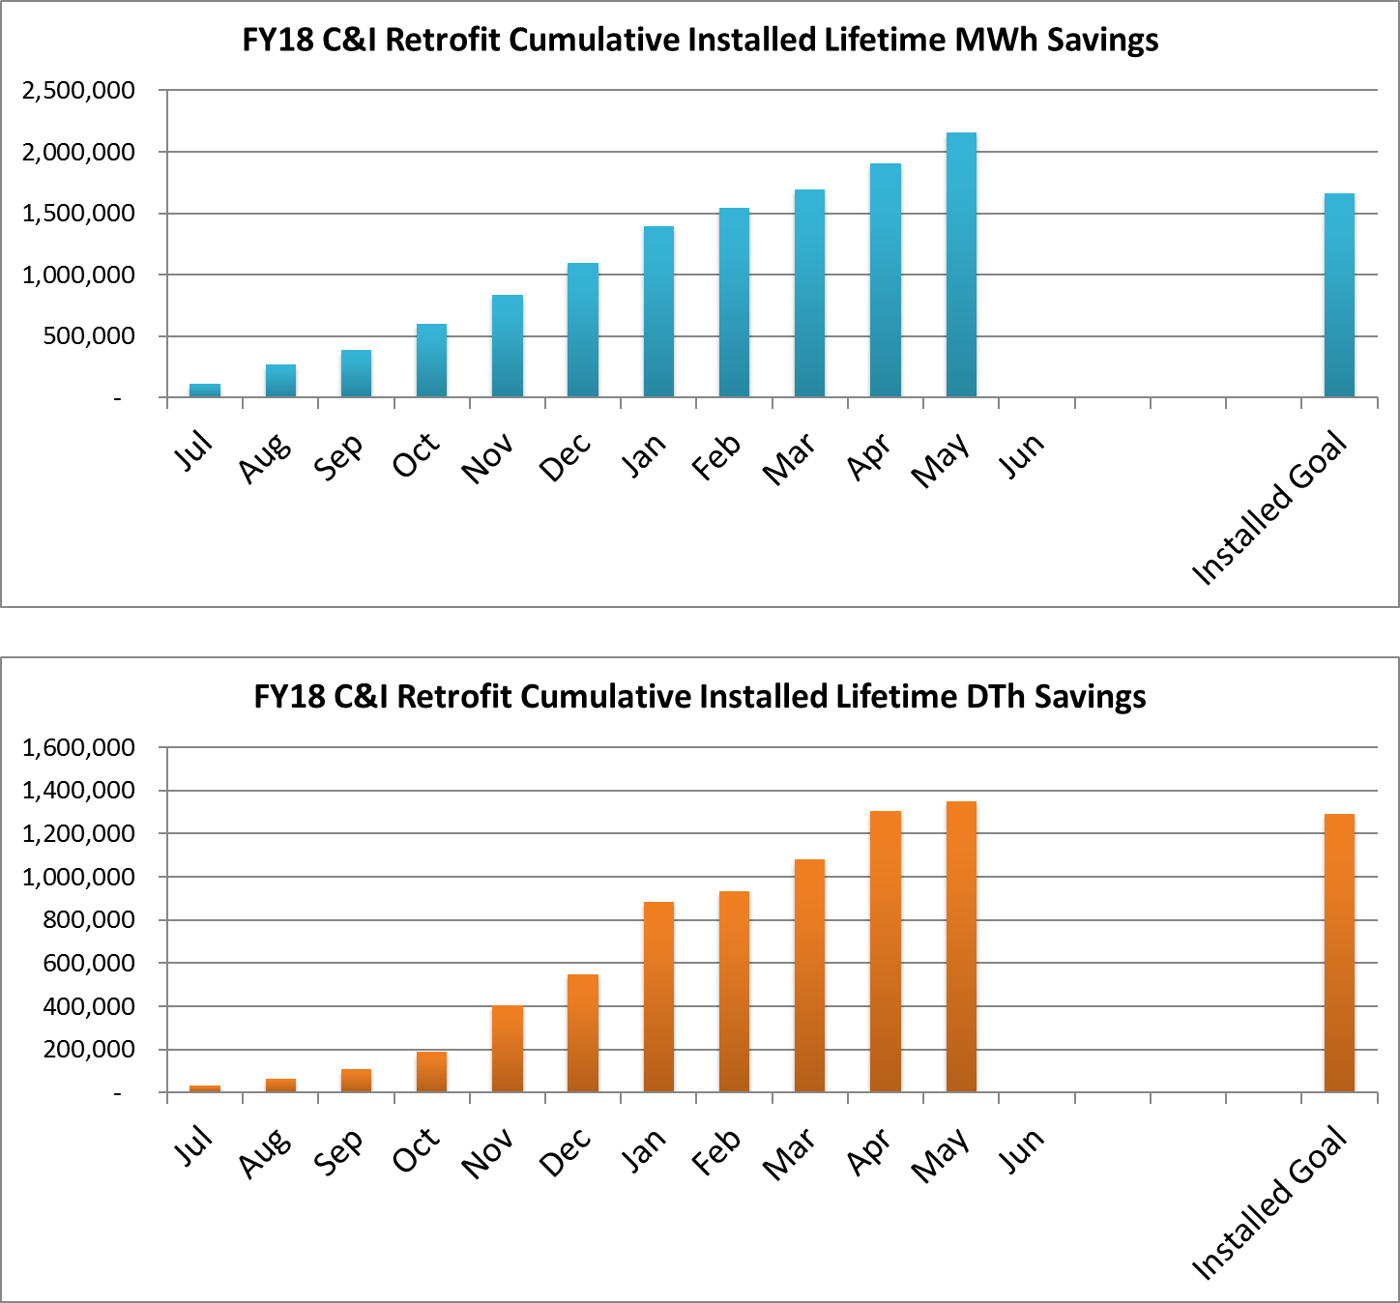
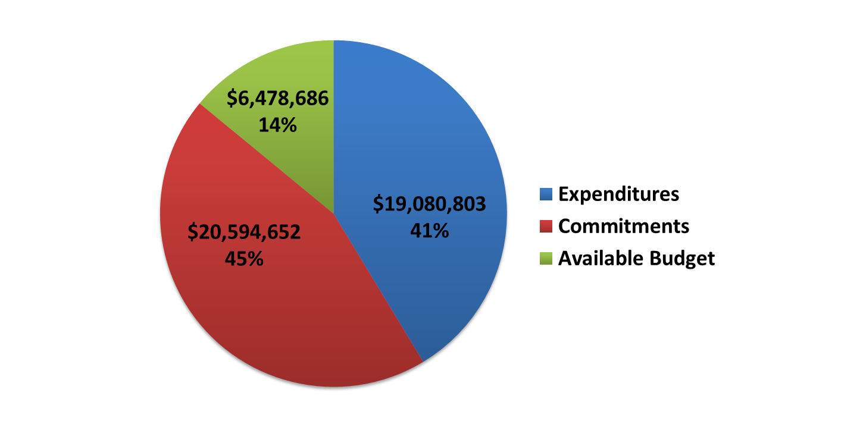
C&I retrofit
(Smartstart buildings)
Program Highlights
  The Customer Tailored Energy Efficient Pilot Program received the 10th new program enrollment and held two scoping sessions
  256 new projects were approved for total potential incentives of $1.41M

Slide 8
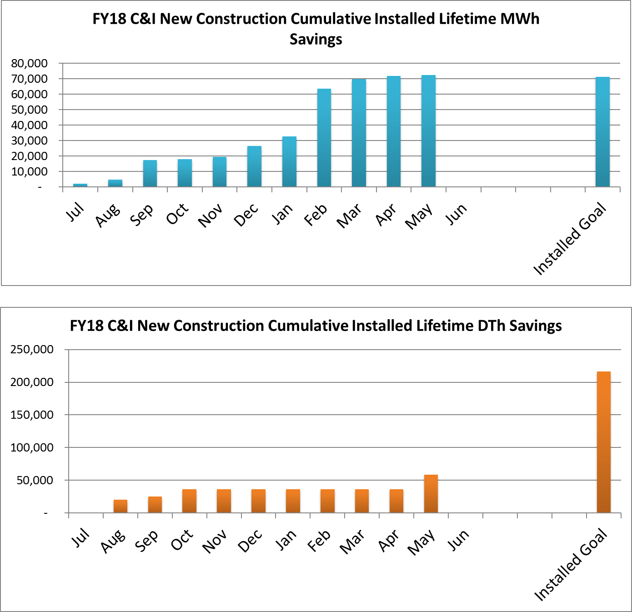
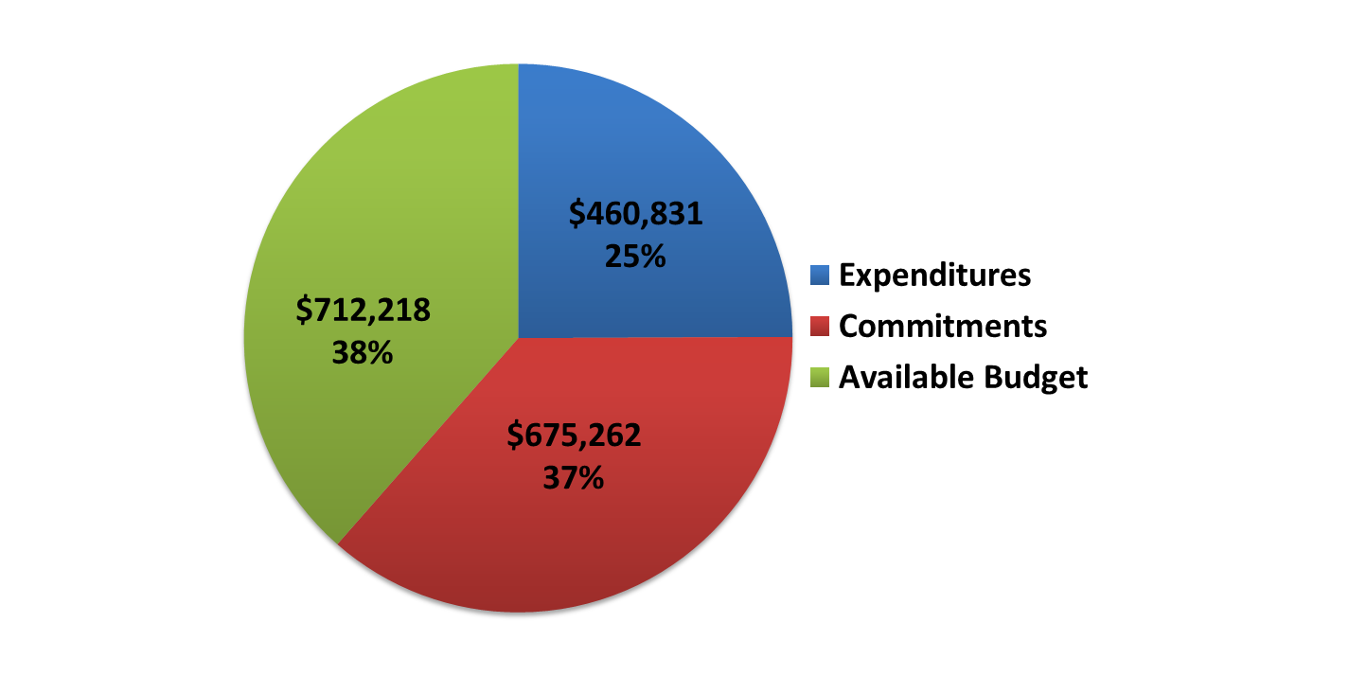
C&I new construction
(smartstart buildings)
Program Highlights
2 new projects were approved for a total potential incentive of $2,317
7 projects paid totaling $21,632.06 in incentives

Slide 9
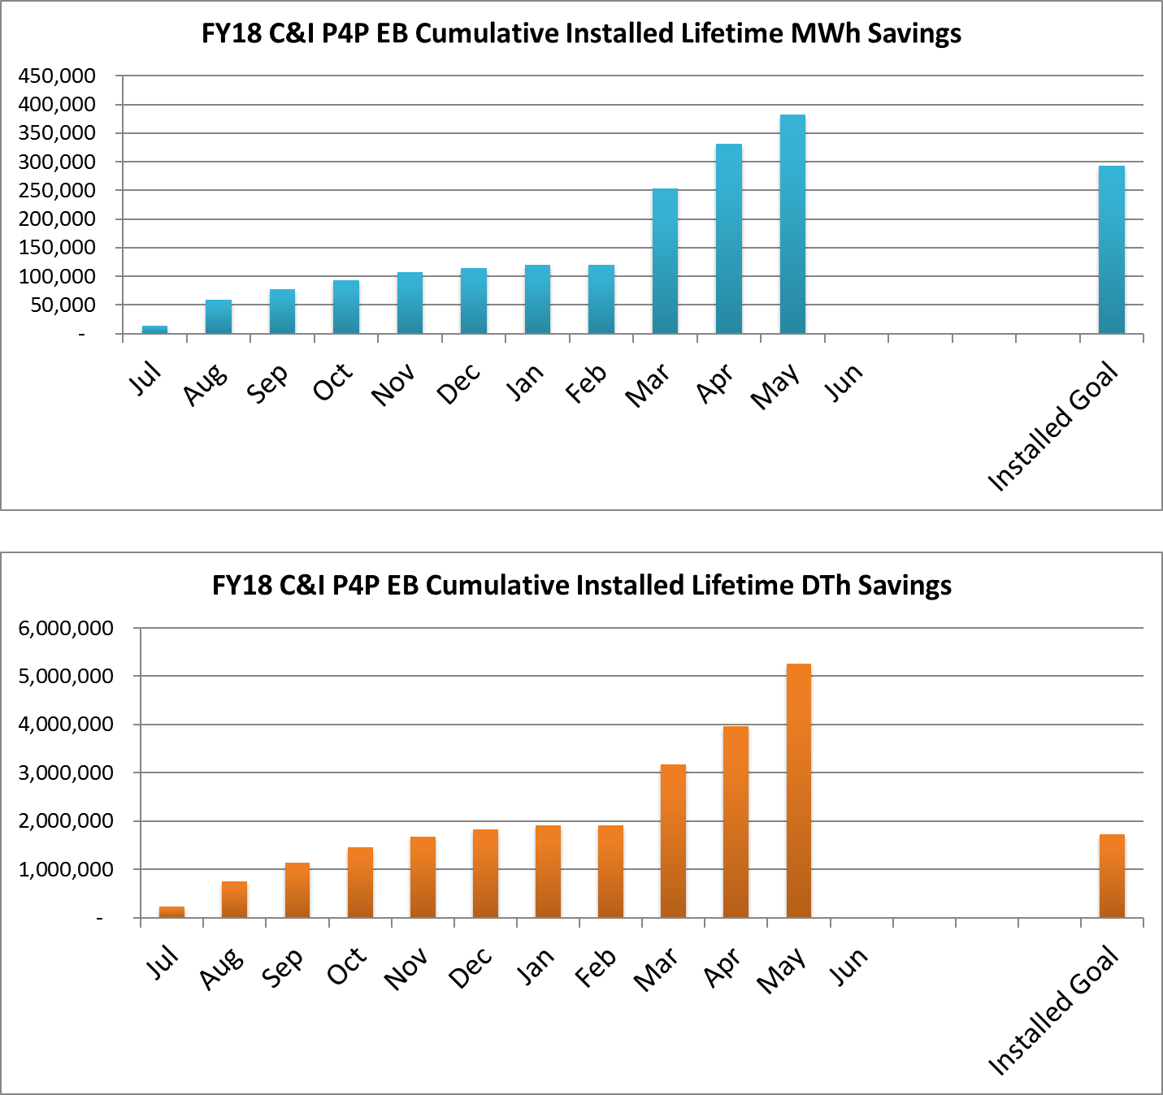
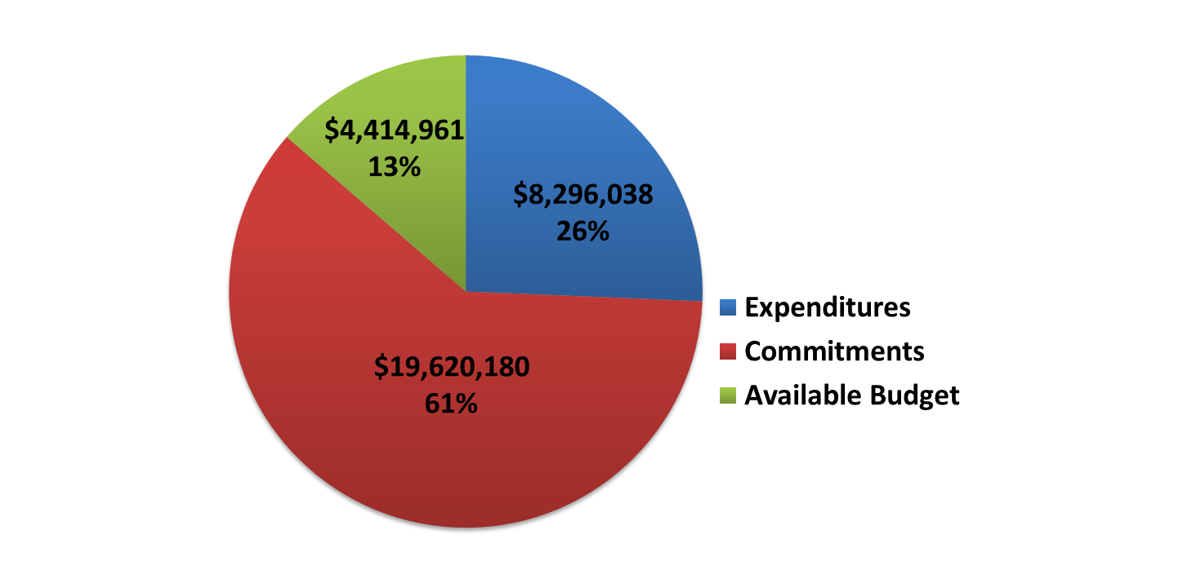
Pay for performance – existing buildings
Program Highlights
  Received 3 new applications, 10 Energy Reduction Plans, 6 Installation Reports and 4 Savings Verification Reports
  Approved 8 new applications, 14 Installation Reports and 1 Savings Verification Report
  New Commitments: $142,540
  Incentives Paid: $1,155,399
Note: The higher than anticipated thermal savings are due to projects being completed with high gas savings.

Slide 10
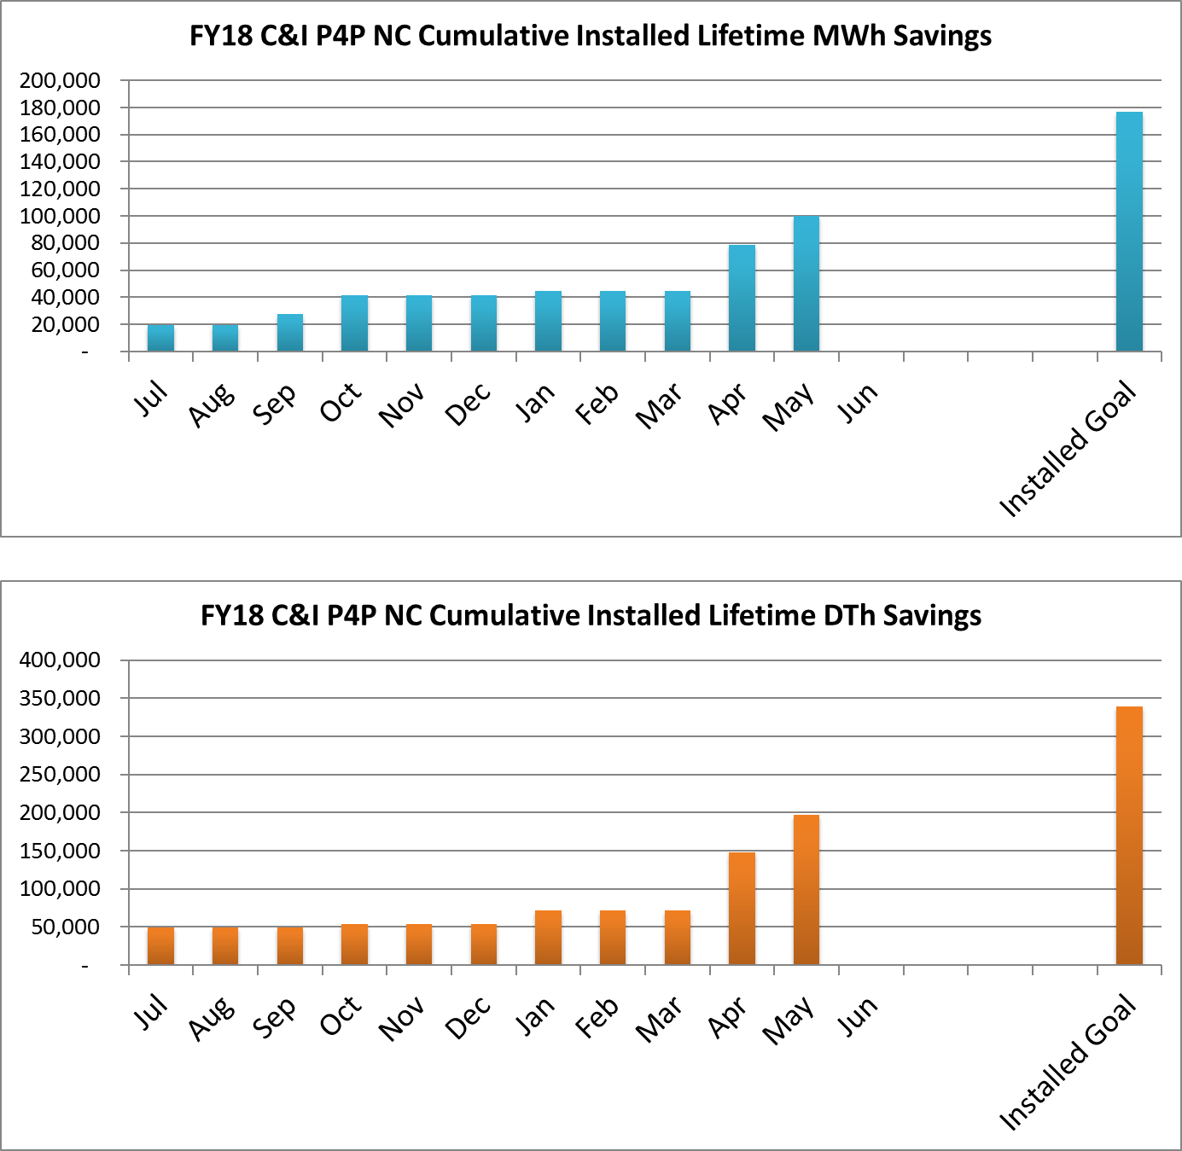
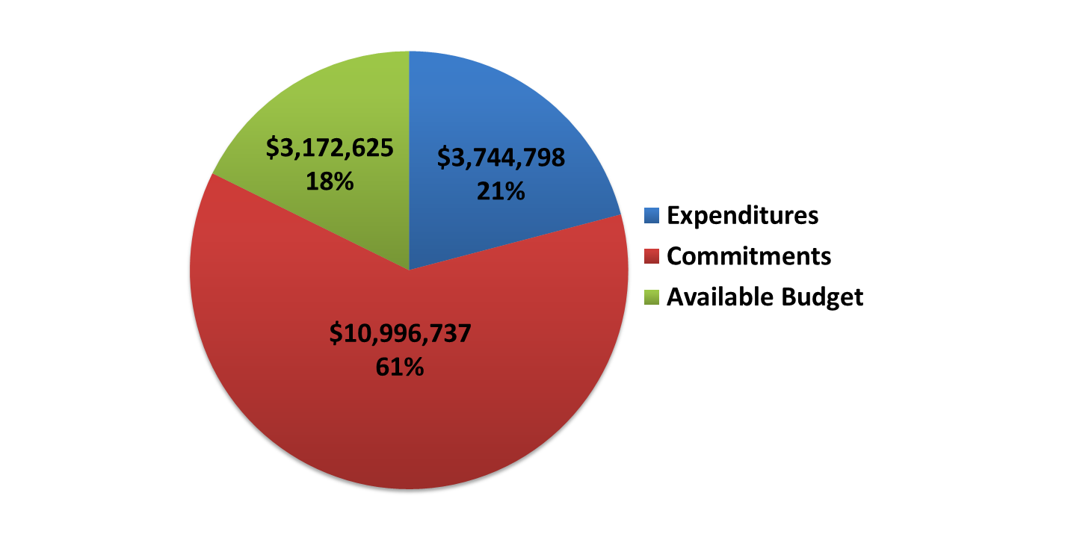
Pay for performance - new construction
Program Highlights
  Received 3 new applications
  Approved 1 new application, 1 Energy Reduction Plan, 4 As-Built Plans and 5 Commissioning Reports
  New Commitments: $357,595
  Incentives Paid: $1,253,314

Slide 11
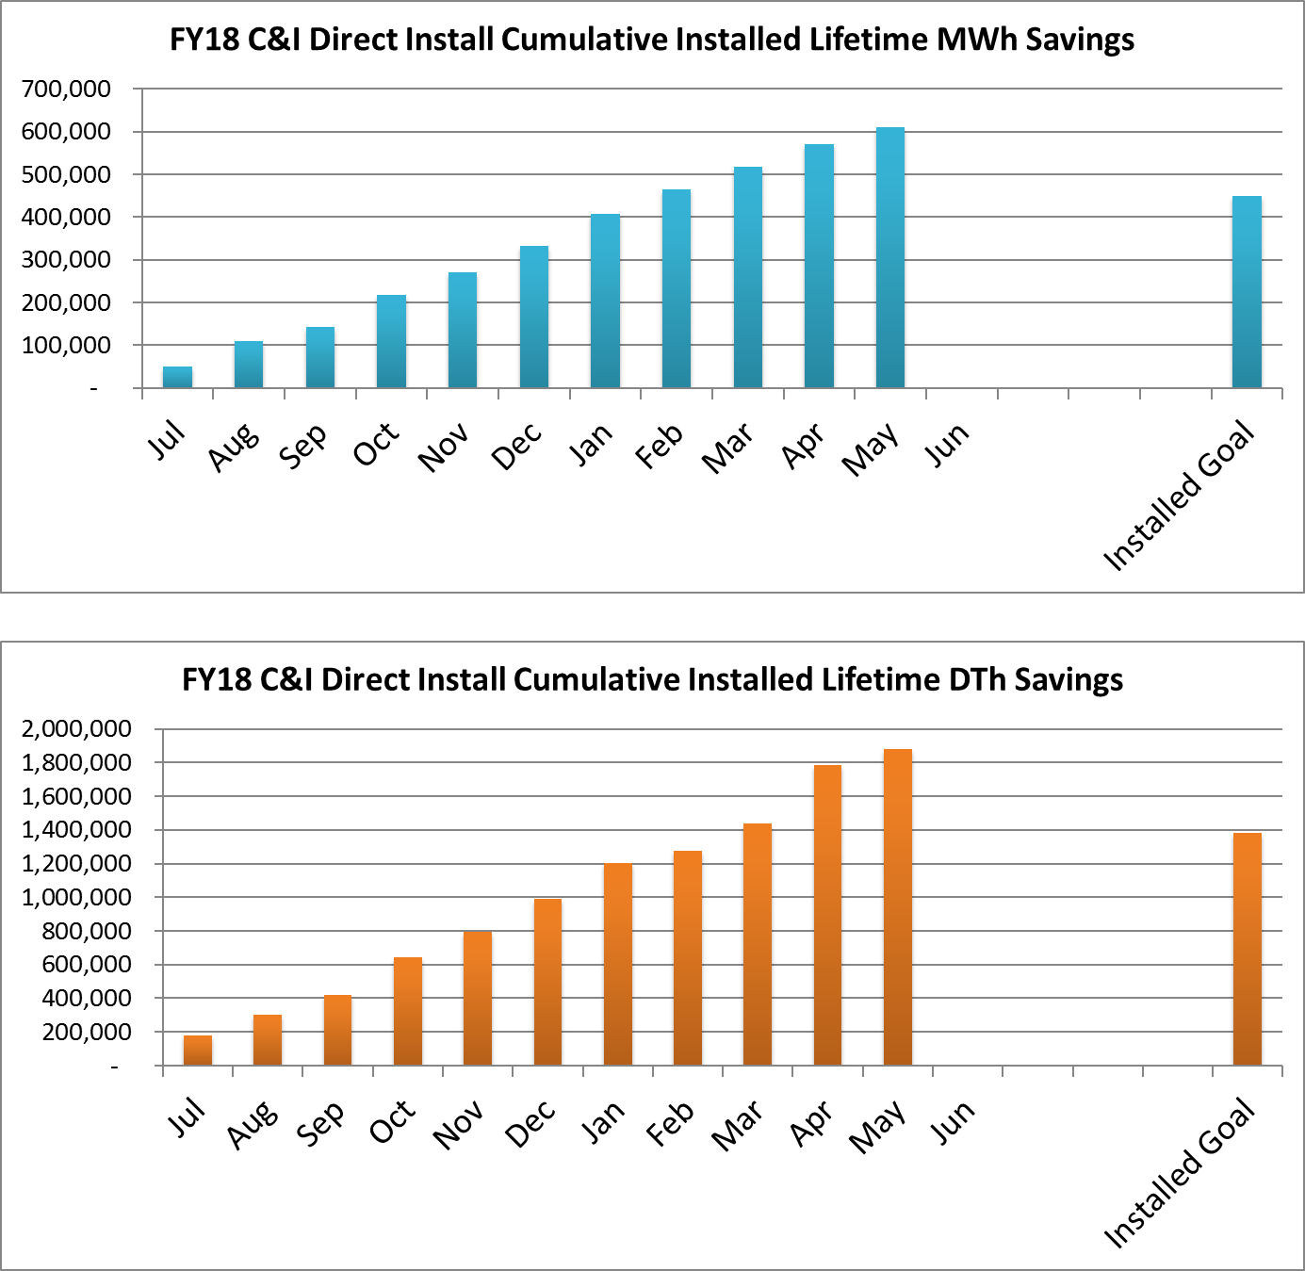
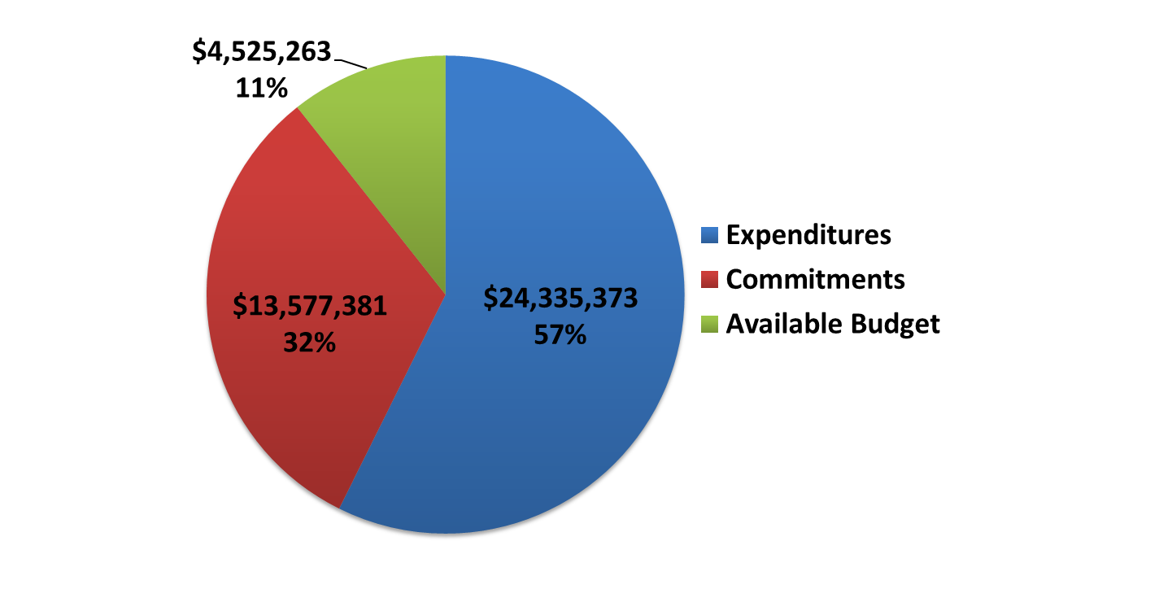
Direct install
Program Highlights
Direct Install contractors received approval to proceed with 114 projects representing $3.48M in commitments
State Energy Program (SEP) funding fully committed

Slide 12
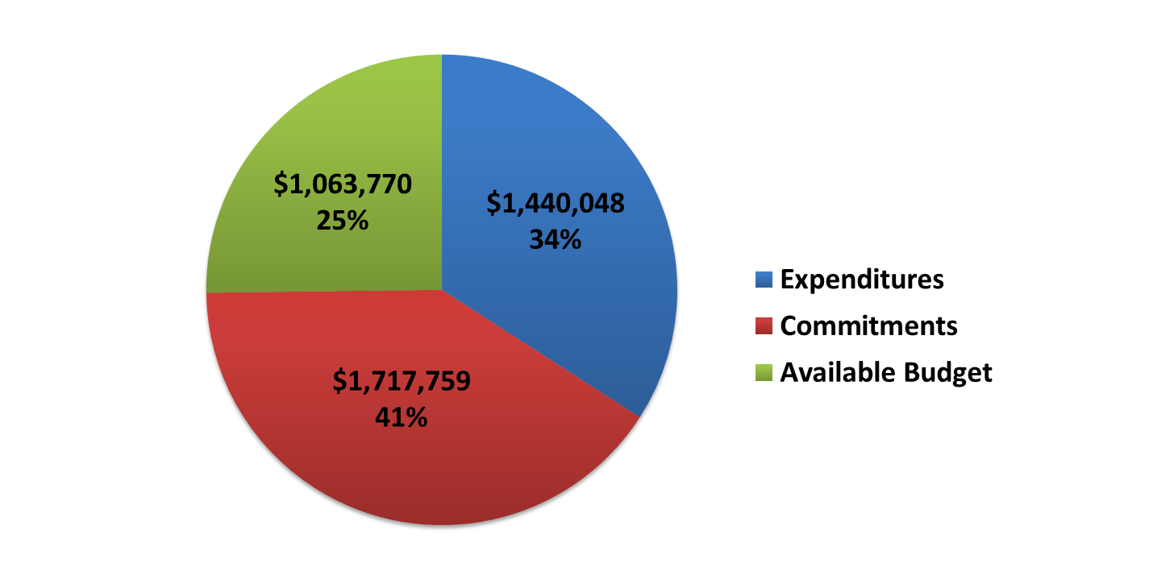
Local government energy audit/Benchmarking
Note: LGEA shows no installed savings as there are no associated savings with an energy audit.
Program Highlights
7 exit meetings completed; A Commissioner attended one meeting with NJ Transit to review audits recently performed on 4 buildings
Benchmarking is included as part of each LGEA report, and an additional 6 benchmarking reports have been completed and delivered

Slide 13
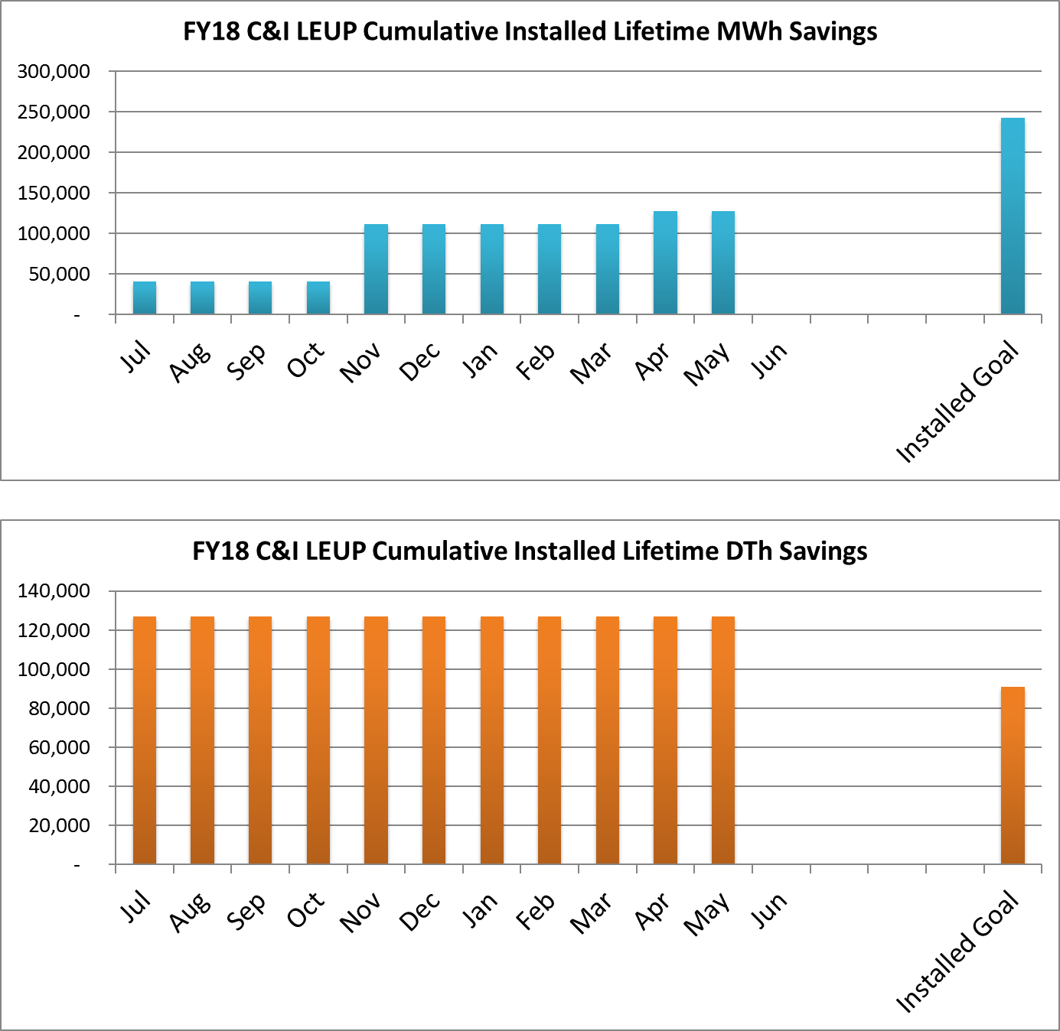
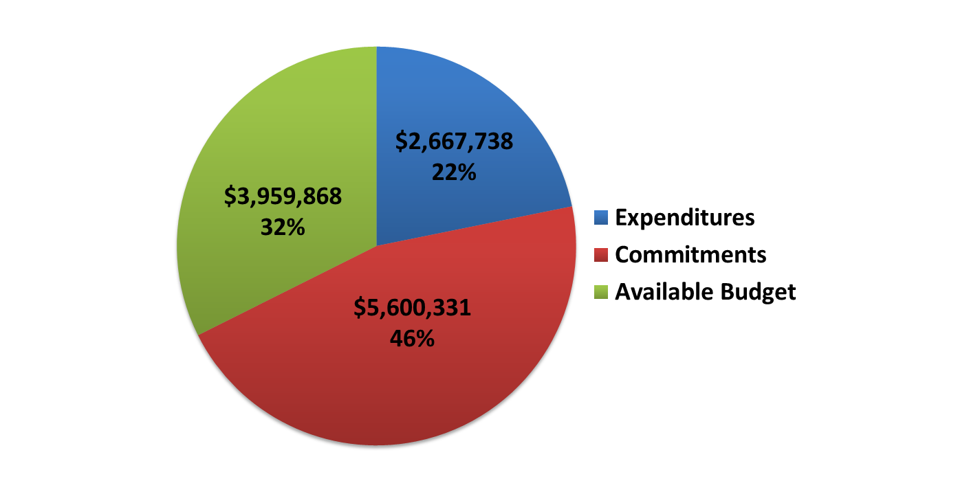
Large energy users program
Program Highlights
1 new enrollment
1 FEEP received; 2 awaiting Board approval; 2 additional under review
1 project completion under review

Slide 14
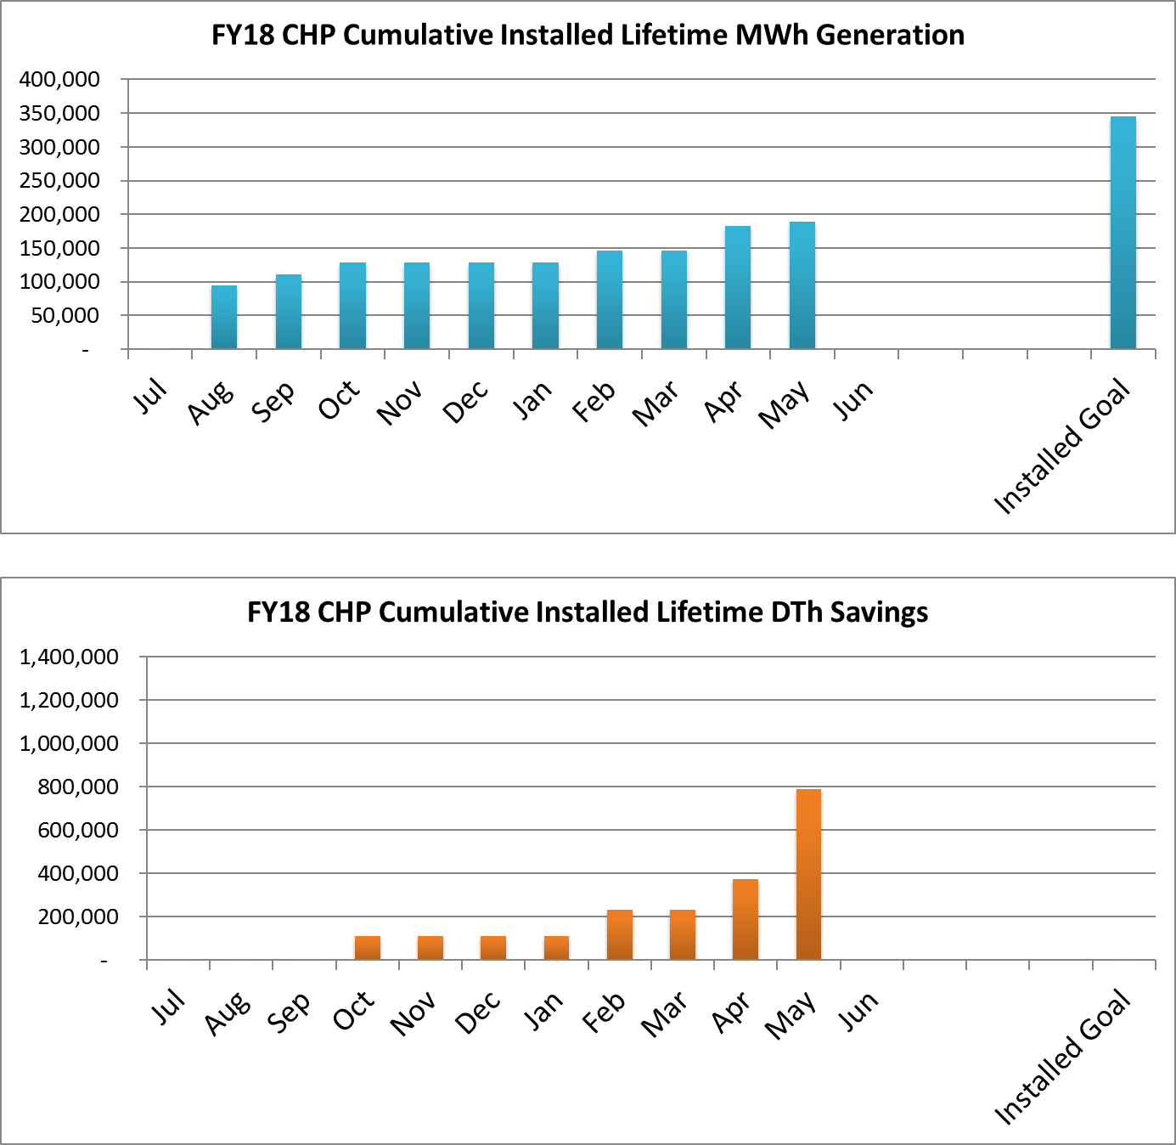
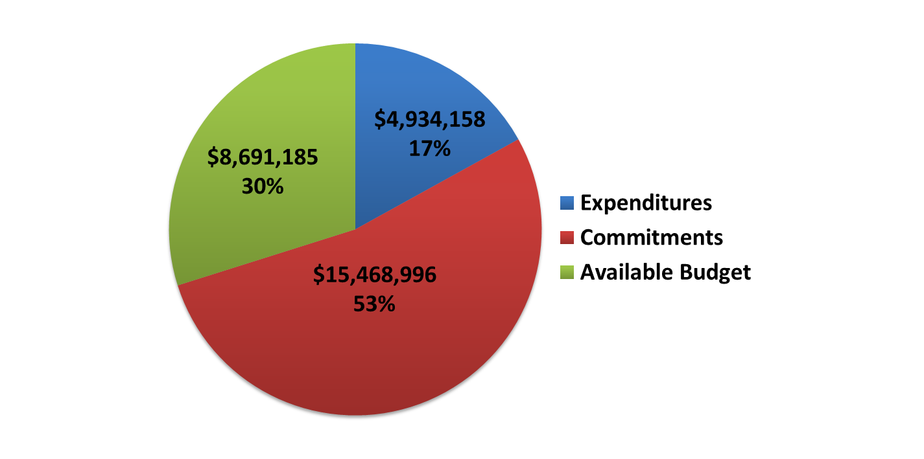
Combined heat & power
Program Highlights
5 projects in the technical review queue, totaling approximately $5.54 M in incentives and 7 MW of capacity

Slide 15
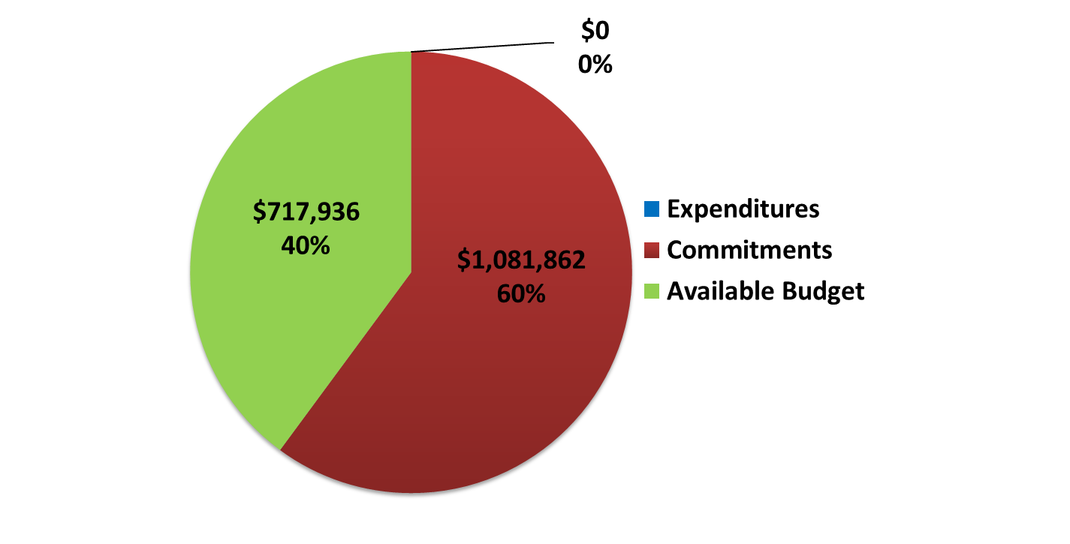
Renewable electric storage
Program Highlights
The program is not accepting new applications in FY 18

Slide 16
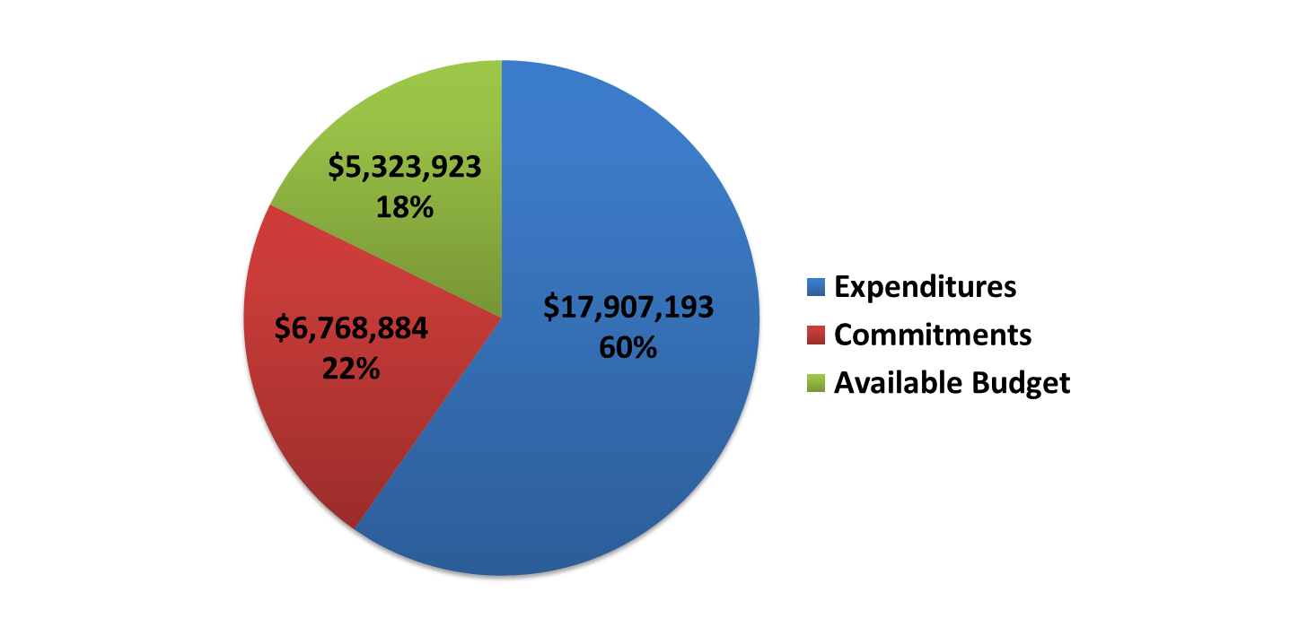
Comfort partners
Program Highlights
Since the program started in 2001, 109,306 customers have been served
  Over 610,739 energy efficient bulbs have been installed
  Over 16,338,607 linear feet of air sealing materials installed
Installed Cumulative Lifetime Savings through 3rd Quarter
  25,397 MWh
  3,298,345 DTh

Slide 17
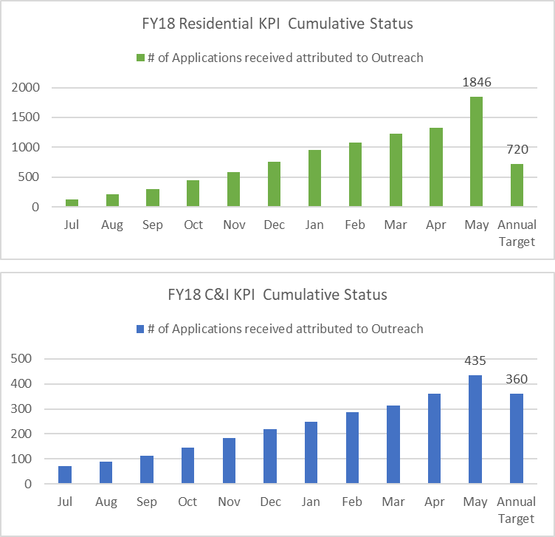
Enhanced Outreach
Program Highlights
12% of Residential HVAC and 9.2% of C&I applications are attributable to outreach
520 HVAC applications attributed to Outreach this month – higher volume than previous 3 months combined
Use of co-op advertising remains strong with 22 ads submitted
A total of 73 C&I applications attributed to Outreach were submitted
Note: Residential applications are HVAC only.
C&I applications do not include LGEA.

Slide 18
FOR MORE INFORMATION
Visit: NJCleanEnergy.com
Call: 866-NJSMART
Stay Informed: NJCleanEnergy.com/NEWSLETTER

